Slide 1
Machine Learning – Linear Regression Inside-Out
Part 3/6 – Code walkthrough and fundamental modelling concepts (such as p-value, Univariate / Bi-variate, scaling, dummies, Model Building, R2 score, RFE, VIF, Correlation etc.)
Sai Kiran Kusumanchi & Vrinda Menon
IDC – Devices Analytics and Data Science Team

Slide 2
Agenda
Introduction to new concepts : 10 mins [Vrinda]
Quick Recap of last session : 2 mins [Sai]
Problem Statement for Todays Case Study : 5 mins [Sai]
Machine Learning Steps and Code Walk Thru : 30 mins [Sai]
Note: Presenters will be pausing between to collect the questions, and our team would be actively monitoring the chat for the questions from attendees.
All the content being presented in the session (PPT + Jupyter Notebook) will be provided to everyone and the session will be recorded.

Slide 3
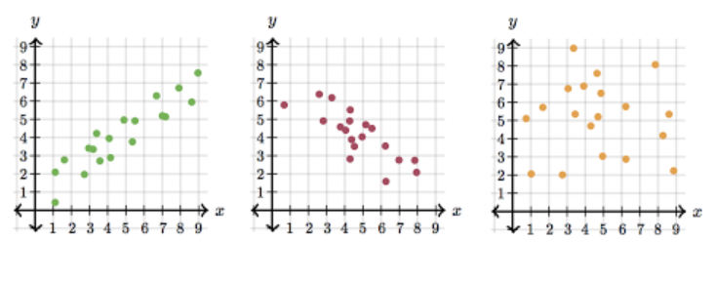
CONCEPTS - REGRESSION MODELS
Correlation: This explains how one or more variables are related to each other.
Multicollinearity: This occurs when independent variables in a regression model are correlated. This can lead to skewed or misleading results
Example : Blood Pressure= m1(age)+m2(Wt in Kgs)+m3(Wt in Pounds)+m4(stress)+c
Here, Weights in Kgs and Weights in Pounds have a positive correlation (1kg =2.2 lb)
Variance Inflation Factor (VIF): VIF score of an independent variable represents how well the variable is explained by other independent variables
**A rule of thumb for interpreting the variance inflation factor:
Between 1 and 5 : allowable
Between 5 and 10 : allowable; needs examination
>10: Discard the variable
Positive Negative Neutral
Notes:
Correlation: This explains how one or more variables are related to each other. It gives us the idea about the degree of the relationship of the two variables.
Positive Correlation : one variable increase then the value of the other variable(s) also increases
Negative Correlation : The value of one variable increase then the value of the other variable(s) decreases
Neutral Correlation : The value of one variable increase or decrease then the value of the other variable(s) doesn’t increase or decreases (add pictures)
Multicollinearity: If the degree of correlation between variables is high enough, it can cause problems when you fit the model and interpret the results
Suppose y=m₁x₁+m₂x₂+m₃x₃+---+c is a linear equation
y = dependent variable (predicted value)
m₁,m₂,m₃… = slope
x₁,x₂,x₃… = independent variable (features)
c = constant

Slide 4
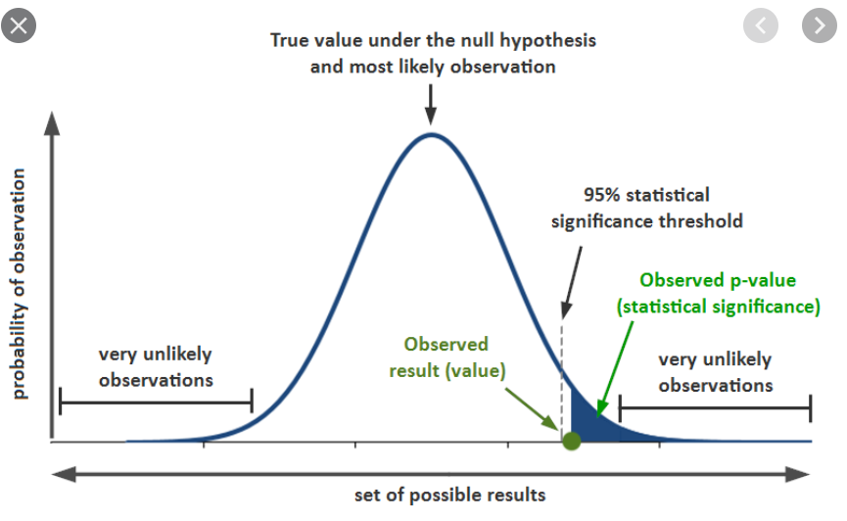


Types of Variables:
Quantitative Variables ( Can be used as – is)
Categorical Variables (Dummies/label encoding)
Dummies : Use of Categorical Variables in Machine learning models
Other E.g.: Male, Female; High, Low, Medium; etc..
P – Value:
This is an important metric in the process of feature selection. In feature selection, we try to find out the best subset of the independent variables to build the model.
Example:
H₀= Bio Fertilizers does not increase the yield in plants
H₁= Bio Fertilizers increases the yield in plants
Null Hypothesis (H₀): The independent variable(x) has no significant effect over the target variable(y)
Alternate Hypothesis(H₁): The independent variable(x) has a significant effect on the target variable(y)
As per industry standards when p<0.05 then independent variable(x)
has effect on target variable(y) for a confidence interval of 0.95.
This may change as per requirement.
Example:
T Shirt Size
Small
Medium
Large
X-Large
Small | Medium | Large | X-Large
1 | 0 | 0 | 0
0 | 1 | 0 | 0
0 | 0 | 1 | 0
0 | 0 | 0 | 1
Notes:
Dummies:
If there are n number of categories in categorical attribute, n-1 new attributes will be created. These attributes created are called Dummy Variables. Hence, dummy variables are “proxy” variables for categorical data in regression models
The P Value basically helps to answer the question: ‘Does the data really represent the observed effect?’.

Slide 5
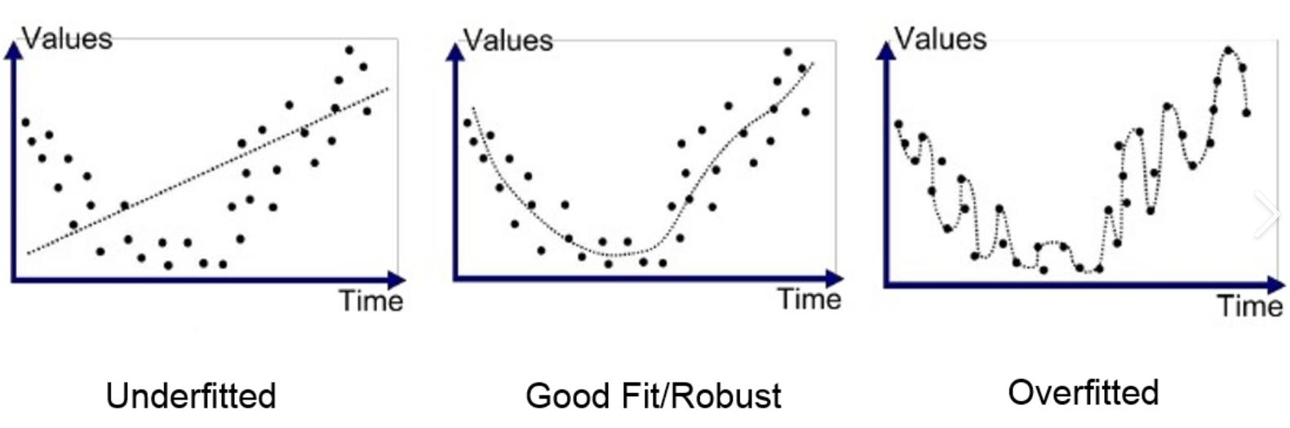
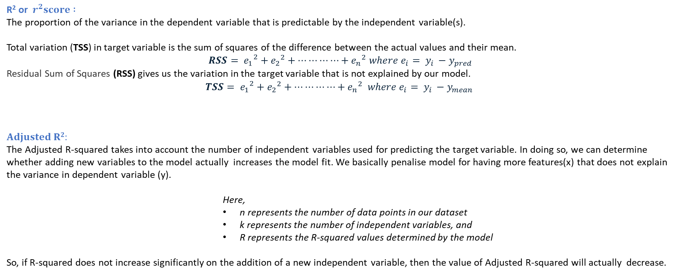
Overfitting : Overfitting is a situation where a model memorizes all the data points in the data set.
This negatively impacts the performance of the model on new data
R² or $r^{2}score :$
The proportion of the variance in the dependent variable that is predictable by the independent variable(s).
Total variation (TSS) in target variable is the sum of squares of the difference between the actual values and their mean.
${{RSS= e}_{1}}^{2}+{e_{2}}^{2}+⋯⋯⋯⋯+{e_{n}}^{2}$ $where{ e}_{i}= y_{i }−y_{pred}$
Residual Sum of Squares (RSS) gives us the variation in the target variable that is not explained by our model.
$${{TSS= e}_{1}}^{2}+{e_{2}}^{2}+⋯⋯⋯⋯+{e_{n}}^{2} where{ e}_{i}= y_{i }−y_{mean}$$
𝐀𝐝𝐣𝐮𝐬𝐭𝐞𝐝 𝐑^{𝟐}:
The Adjusted R-squared takes into account the number of independent variables used for predicting the target variable. In doing so, we can determine whether adding new variables to the model actually increases the model fit. We basically penalise model for having more features(x) that does not explain the variance in dependent variable (y).
Here,
n represents the number of data points in our dataset
k represents the number of independent variables, and
R represents the R-squared values determined by the model
So, if R-squared does not increase significantly on the addition of a new independent variable, then the value of Adjusted R-squared will actually decrease.
Notes:
How much
R² assumes that every single variable explains the variation in the dependent variable. The adjusted R² tells you the percentage of variation explained by only the independent variables that actually affect the dependent variable.% of your prediction can be explained by your model.

